Slide 1
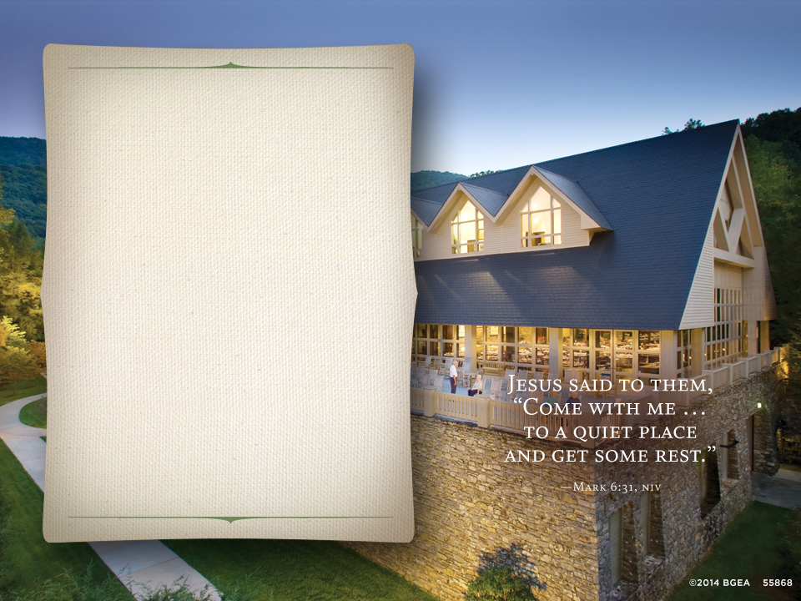
Your Event
Here
Your Event Date Here
Title
Topic
Speaker info

Slide 2
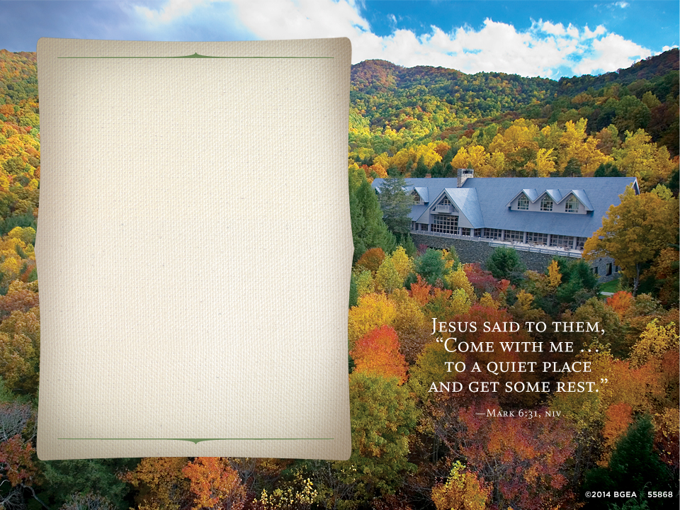
Your Event
Here
Your Event Date Here
Title
Topic
Speaker info

Slide 3

A setting like
no other
1,200 secluded acres in the
Blue Ridge Mountains
Rich natural forest with
woodland streams
Wraparound deck with panoramic views
Solitude for quiet retreat

Slide 4
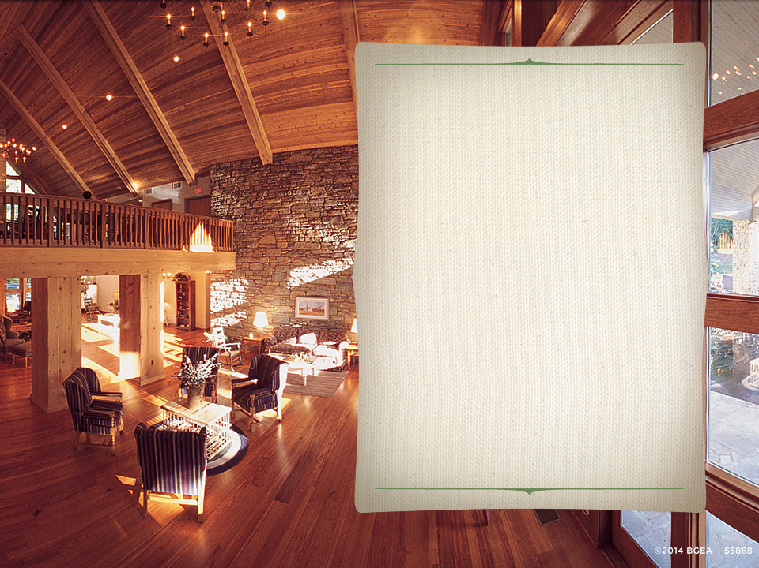
Inviting atmosphere
and distinctive facilities
First-class accommodations
Spacious meeting rooms
Excellent service
Warm hospitality

Slide 5


Cordial dining and comfortable lodging
Superb cuisine
Charming country inns
24-hour complimentary refreshments

